Slide 1
Entity-Relationship Model
Lecture # 2
Imran Siddiqi
imran.siddiqi@mcs.edu.pk
Computer Science Department
College of Telecommunication Engineering
National University of Sciences and Technology

Slide 2
Contents
Keys – Super, candidate, primary
Placement of Relationship Attributes
Weak Entities
ER Diagram - Notations
Class Hierarchies
  Generalization & Specialization
  Constraints on Generalization & Specialization

Slide 3


Keys
Super Key
A set of one or more attributes that, taken collectively, allow us to identify uniquely an entity in the entity set
Customer_ID
Customer_ID, Customer_Name
Customer_ID, Customer_Address
Customer_Name
If K is a super K so is any superset of K

Slide 4
Keys
Candidate Key
The minimal superkeys for which none of its proper subsets is a superkey are called candidate keys
Customer_ID
Customer_ID, Customer_Name
Primary Key: The principle key chosen by the DB designer

Slide 5
Keys for Relationship Sets
R – Relationship set involving entities E₁,E₂, …, E_{n}
The set of attributes:
primary-key(E₁) U primary-key(E₂) U …U primary-key(E_{n})
Forms a superkey for the relationship set R

Slide 6
Keys for Relationship Sets
Example
Customer
Borrows
Loan
Key of Borrows?
If the relationship is M:N primary-keys of Customer & Loan
If the relationship is 1:M primary-key of Loan
If the relationship is 1:1 primary-key of either entity

Slide 7

Reading Assignment
2.4.1 Use of Entity Sets versus Attributes
2.4.2 Use of Entity Sets versus Relationship Sets

Slide 8
Placement of Relationship Attributes
Design Decision
Access_Date
Customer
holds
Account
If the relationship is 1:1
Access_Date can be attribute of either entity
If the relationship is 1:M
Access_Date can be attribute of Account

Slide 9
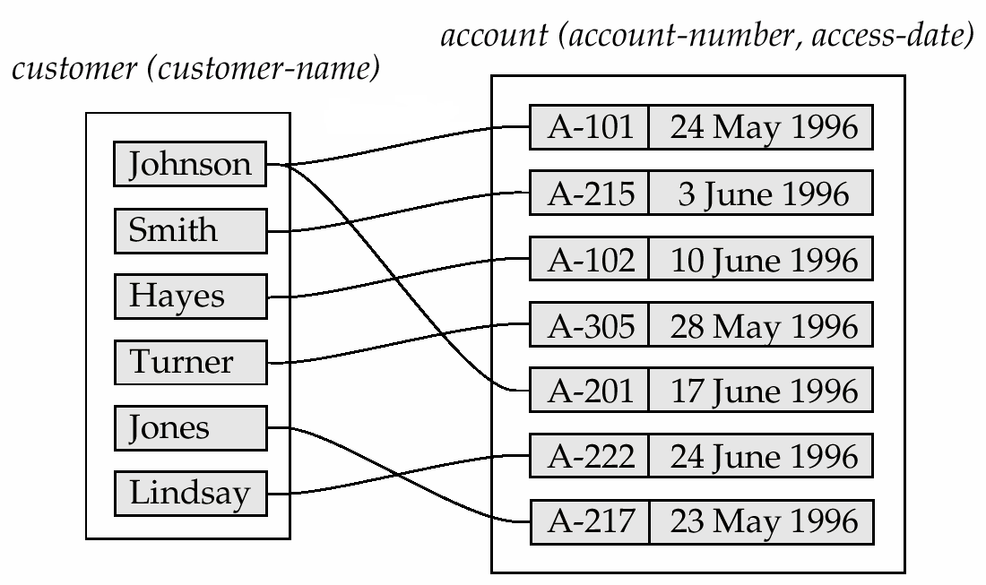
Placement of Relationship Attributes
If the relationship is 1:M
Attributes of the relationship can be placed at the ‘many’ side

Slide 10
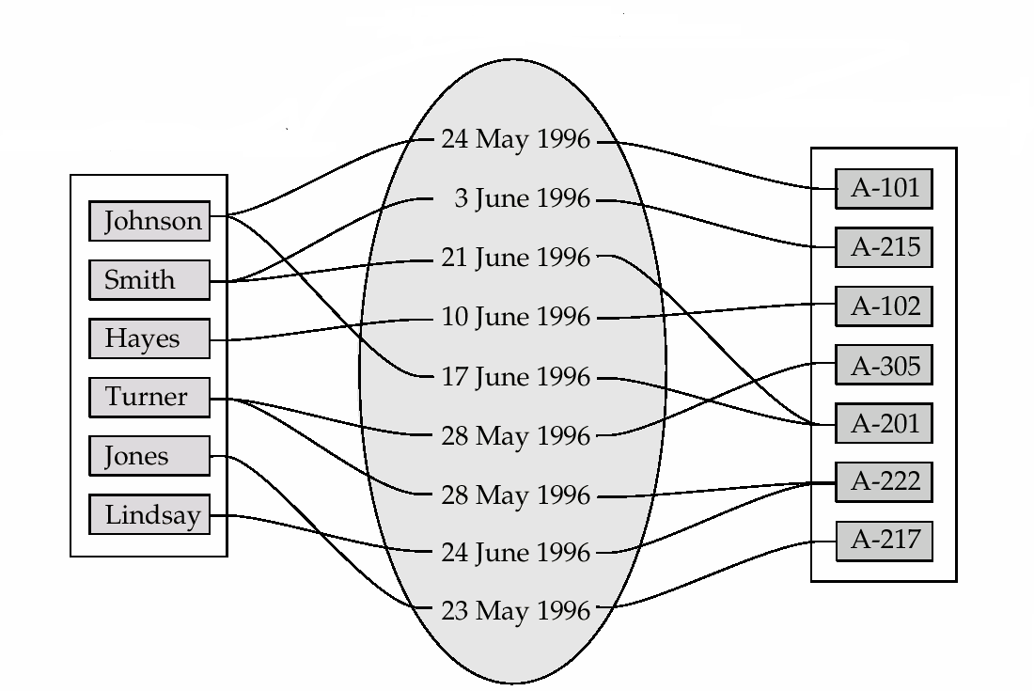
Placement of Relationship Attributes
If the relationship is M:N
Access_Date must be associated with the relationship
Holds(Access_Date)
Account(Account_Number)
Customer(Customer_Name)

Slide 11
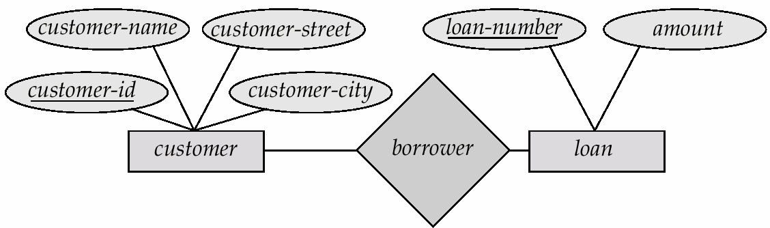
Entity Relationship Diagram
Rectangles represent entity sets.
Diamonds represent relationship sets.
Lines link attributes to entity sets and entity sets to relationship sets.
Ellipses represent attributes
  Double ellipses represent multivalued attributes.
  Dashed ellipses denote derived attributes.
Underline indicates primary key attributes

Slide 12
ER Diagram
Representing Cardinalities
Relationship from customer to loan is one to many
Directed line represents 1
Un-directed line represents M

Slide 13
ER Diagram: Cardinality Constraints
We express cardinality constraints by drawing a directed line (→), signifying “one,” and an undirected line (—), signifying “many,” between the relationship set and the entity set.
Directed line represents 1
Un-directed line represents M

Slide 14
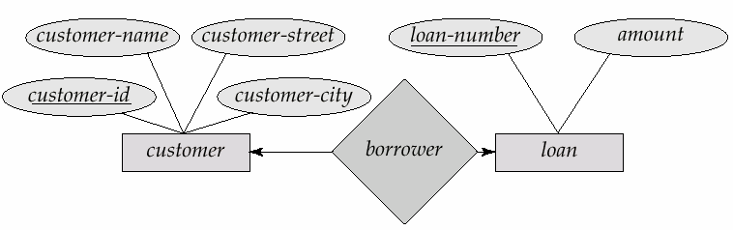
One to One Relationships
A customer is associated with at most one loan via the relationship borrower
A loan is associated with at most one customer via borrower

Slide 15
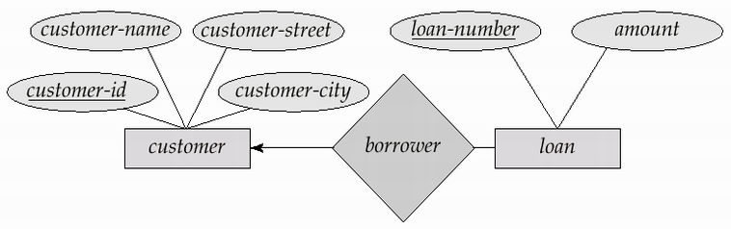
One to Many Relationship
In the one-to-many relationship a loan is associated with at most one customer via borrower, a customer is associated with several (including 0) loans via borrower

Slide 16
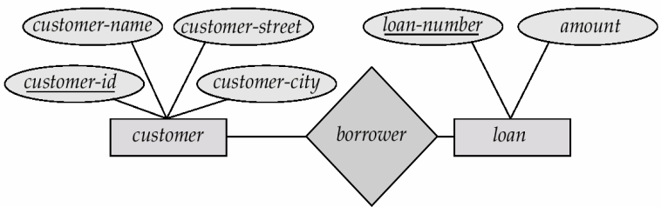
Many to Many Relationship
A customer is associated with several (possibly 0) loans via borrower
A loan is associated with several (possibly 0) customers via borrower

Slide 17
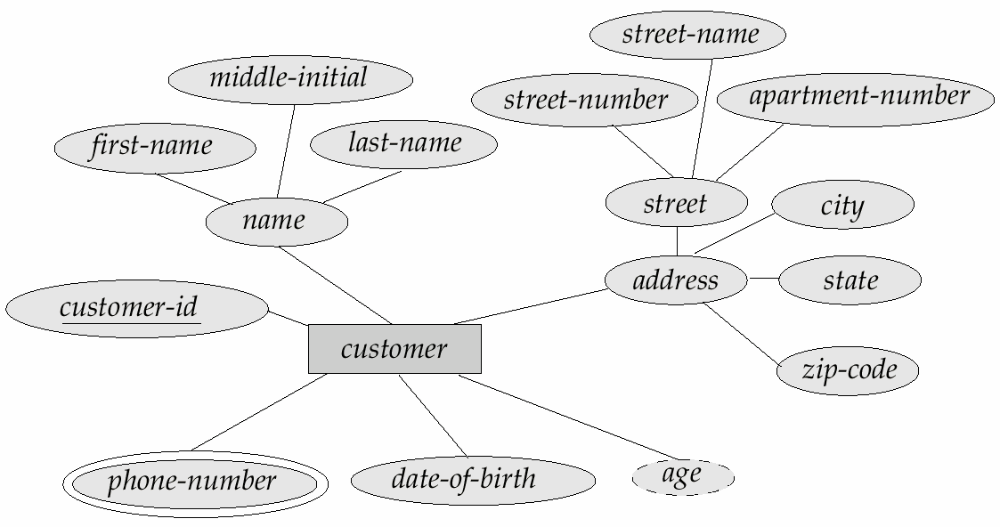
ER Diagram: Composite, Derived & Multi-valued Attributes

Slide 18
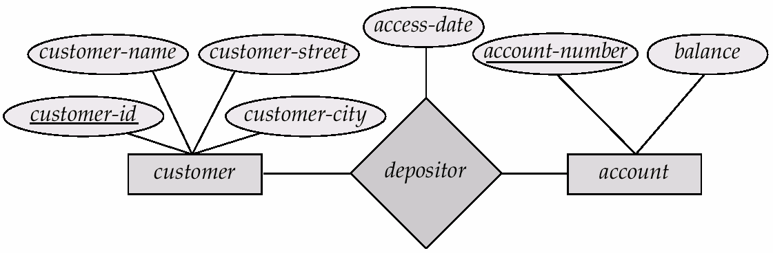
ER Diagram: Relationship Set with Attributes

Slide 19
ER Diagram: Participation Constraints
Recap
Total Participation (Double line)
Every entity in the entity set participates in at least one relationship in the relationship set
  E.g. participation of loan in borrower is total
    every loan must have a customer associated to it via borrower
Partial Participation
Some entities may not participate in any relationship in the relationship set
  E.g. participation of customer in borrower is partial

Slide 20
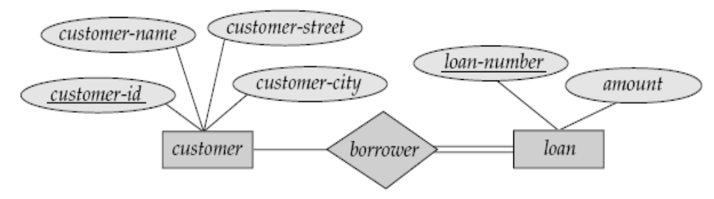
ER Diagram: Participation Constraints

Slide 21
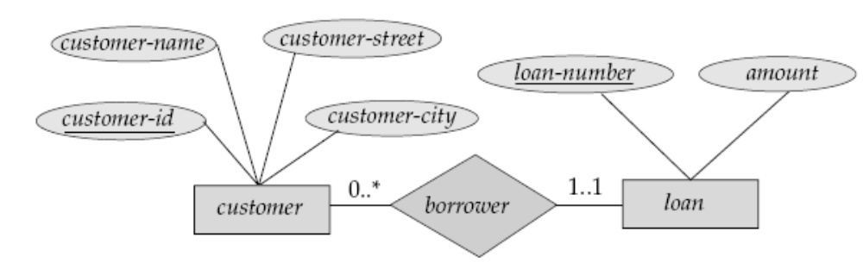
ER Diagram: Alternative Notation for Cardinality Limits
Cardinality limits can also express participation constraints
Min..Max
Min = 1 indicates total participation
Max= 1 indicates entity participates in at most 1 relationship
Max = * indicates no limits

Slide 22
ER Diagram: Alternative Notation for Cardinality Limits
1..1 = Each loan will have only one customer
0..* = Customer can have zero or more loans
What is the relationship? 1:1 or 1:m or m:n

Slide 23
ER Diagram: Alternative Notation for Cardinality Limits
1..1 = Each loan will have only one customer
0..* = Customer can have zero or more loans
What if the customer edge was 1..* ?
What if the customer edge was 1..1?

Slide 24
Weak Entity Sets
An entity set that does not have a primary key is referred to as a weak entity set.
The existence of a weak entity set depends on the existence of a identifying entity set

Slide 25
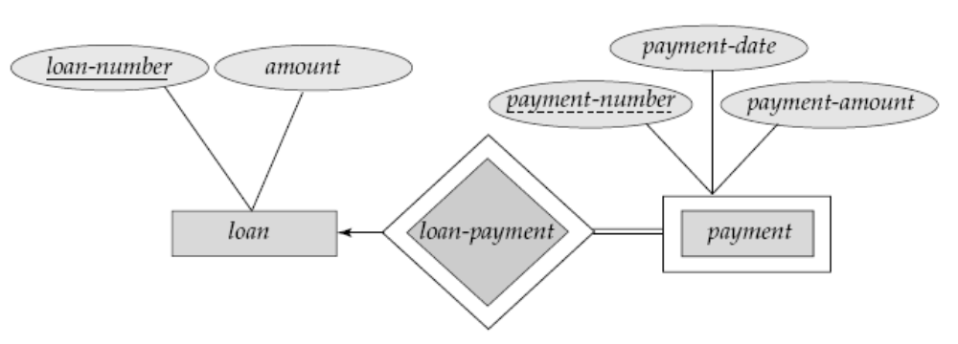
Weak Entity Sets
A loan may have 240 payments, each identified by a payment no 1 - 240.
  The PaymentNo is unique given a particular loan but not unique globally
PaymentNo is called partial key or discriminator
The primary key of Payment is the combination of
LoanNo and PaymentNo.

Slide 26
Weak Entity Sets
Question 1
What is the cardinality of a weak relationship?
Question 2
What is the participation of weak entity set?
The identifying relationship is MANY TO ONE from the weak entity set to the identifying entity set and the participation of the weak entity set is TOTAL

Slide 27
Class Hierarchies
Entity Set – Person
  Name, DoB, Street, City
Person can be classified into Customer and Employee
Entity Set – Customer
  Name, DoB, Street, City, CustomerID
Attributes of entity person
Entity Set – Employee
  Name, DoB, Street, City, EmployeeID, Salaray

Slide 28
Class Hierarchies
Sometimes we need to define entities as “derivations” of others
The attributes of an entity are those of another entity (its
parent) plus other ones
A class hierarchy can be seen in two different ways:
  Specialization
  Generalization

Slide 29
Specialization
Top-down design process
Depicted by a triangle component labeled ISA (E.g. customer “is a” person)
The ISA relationship also referred to as superclass - subclass relationship
Can be applied repeatedly

Slide 30
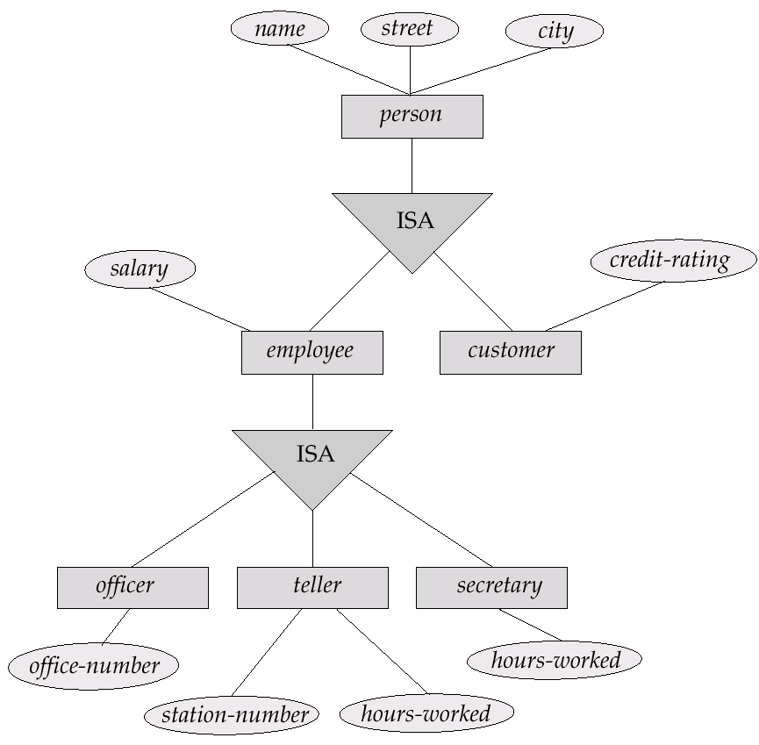
Example

Slide 31
Generalization
Simple Inversion of Specialization
Bottom-Up Approach
Entity Set – Customer
  Name, DoB, Street, City, CustomerID
Commone Attributes
Entity Set – Employee
  Name, DoB, Street, City, EmployeeID, Salaray
Create an entity person with these common attributes

Slide 32
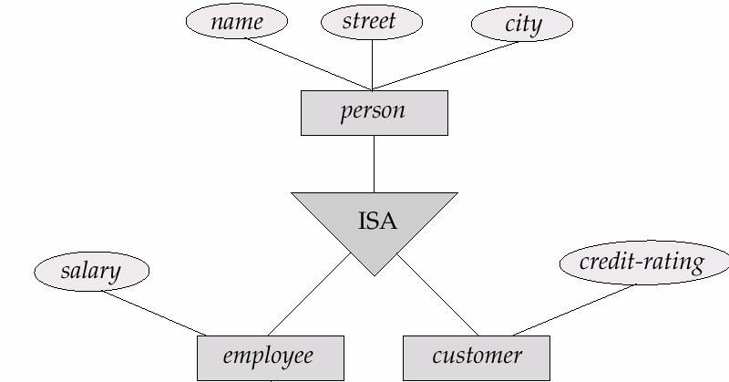
Class Hierarchies
In terms of ERD, no distinction is made between Specialization and Generalization

Slide 33
Attribute Inheritance
A lower-level entity set inherits all the attributes and relationship participation of the higher-level entity set to which it is linked.
Employee and Customer have attributes of person
If person participates in a relationship so do Employee and Customer

Slide 34
Constraints on Specialization & Generalization
Constraints on which entities can be members of a given lower-level entity set
Condition-defined
  E.g. all customers over 65 years are members of senior-citizen entity set; senior-citizen ISA person.
User-defined
  Not assigned automatically
  Implemented by the designer

Slide 35
Constraints on Specialization & Generalization
Constraint on whether or not entities may belong to more than one lower-level entity set within a single generalization
Disjoint
  An entity can belong to only one lower-level entity set
  An account type can be savings or checking
  Noted in E-R diagram by writing disjoint next to the ISA triangle
Overlapping
  An entity can belong to more than one lower-level entity set
  A customer can be employee as well

Slide 36
Constraints on Specialization & Generalization
Completeness constraint -- specifies whether or not an entity in the higher-level entity set must belong to at least one of the lower-level entity sets within a generalization
Total
  An entity must belong to one of the lower-level entity sets
  E.g. The account generalization is total
Partial
  An entity need not belong to one of the lower-level entity sets
  Example
    Bank employees are assigned to one of four teams after a certain job duration
    Some employees might not be part of any team

Slide 37
Aggregation
Sometimes a relationship needs to relate one relationship with a collection of entities or other relationships
Aggregation allows us to indicate that a relationship set participates in another relationship set
Sponsors
Department
Projects
Employees
Related to …
Department assigns employees to monitor the sponsorship

Slide 38
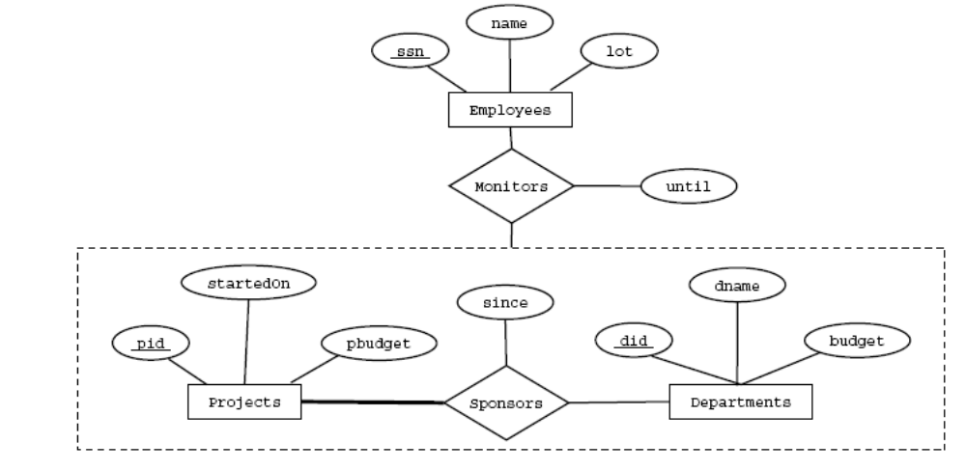
Aggregation
Illustrated by drawing a dashed box around the set of related entities and relationships

Slide 39
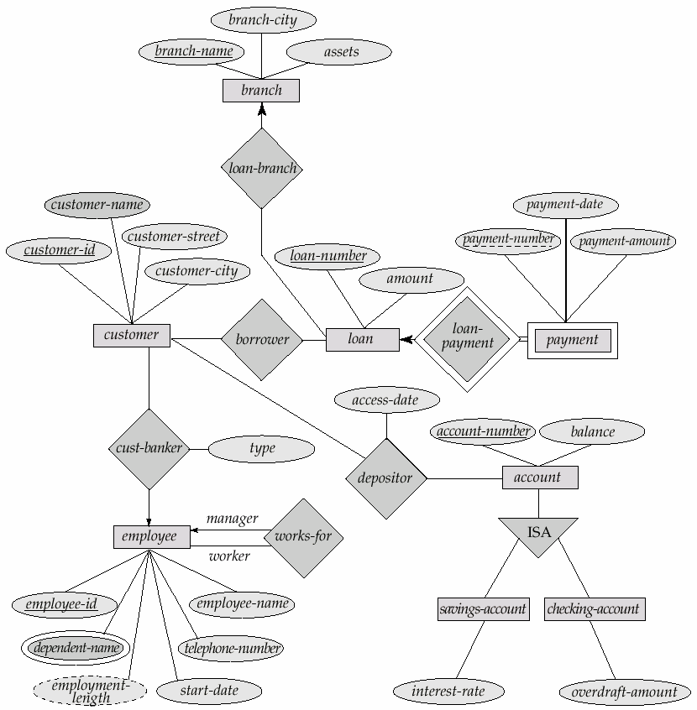
ERD – Banking Enterprise

Slide 40
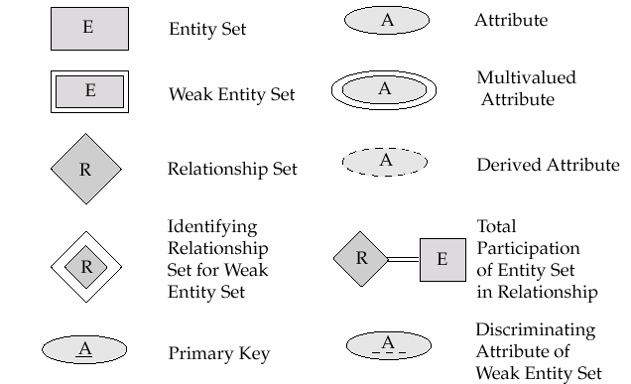
ERD – Symbol Summary

Slide 41
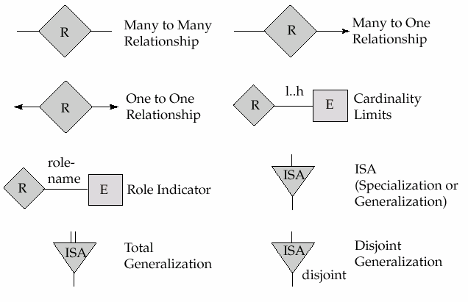
ERD – Symbol Summary

Slide 42
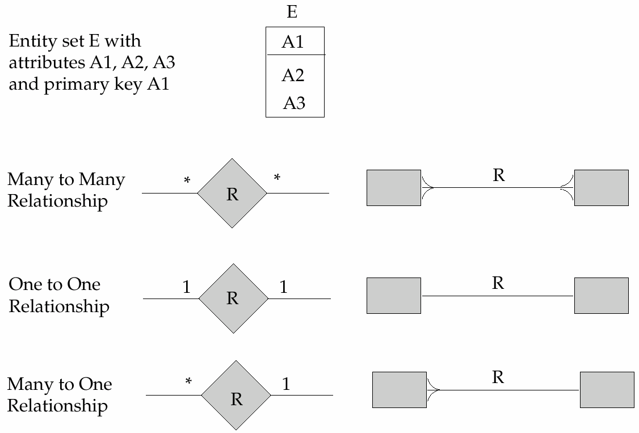
ERD – Alternative Notations

Slide 43
References
Chapter 2, Database System Concepts, Silberschatz, Korth, Sudarshan

